Slide 1
Volcano Formation

Slide 2
By the end, you should be able to:
1. Explain how a volcano is built up by molten rock;
2. Discuss the role of hotspots in volcano formation.

Slide 3
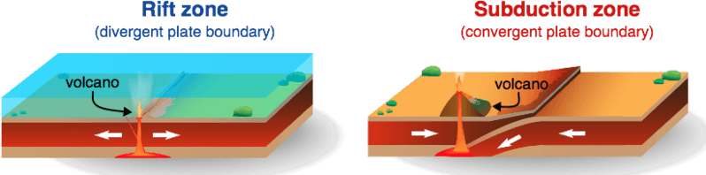
Volcanoes form in any place where molten (liquid) rock rises up to the Earth's surface.
Molten rock found below the ground is known as magma. If it breaks through the ground, it becomes lava.

Slide 4
Over three-quarters of the world's active volcanoes are found around the edge of the Pacific Ocean. Most of them are associated with subduction zones.
If you mark all these volcanoes on a map, you get a shape that scientists call the Pacific Ring of Fire.
The Ring of Fire is famous not only for its volcanoes, but also for the devastating earthquakes that sometimes occur.

Slide 5
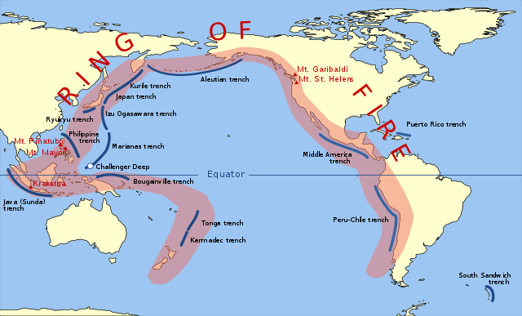

Slide 6
Volcanic eruptions have produced a large portion of the rocks in the Earth's crust.
Oceanic crust, for example, is mainly composed of a darkly coloured rock called basalt. It's the most common rock type in the world - and it is formed by volcanic eruptions!
Other volcanic rocks include andesite, rhyolite and obsidian, all of which are important ingredients in the crust of our planet.

Slide 7
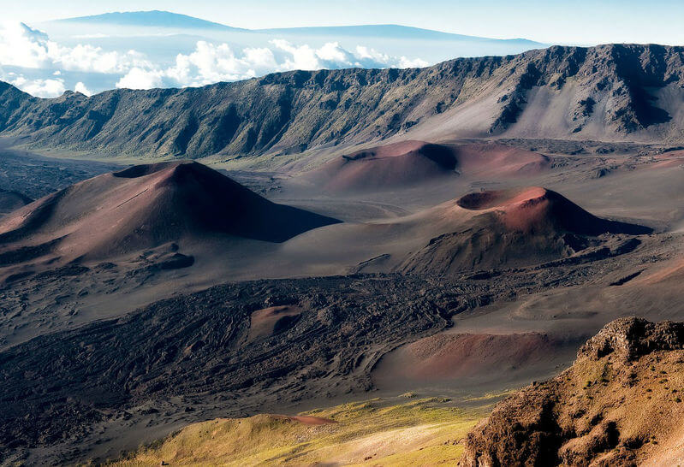
So far we've only talked about volcanoes that form at or near tectonic plate boundaries.
It is also possible to have active volcanoes in the middle of a plate, away from any plate boundaries.
The places where volcanoes of this type form are called hotspots.

Slide 8
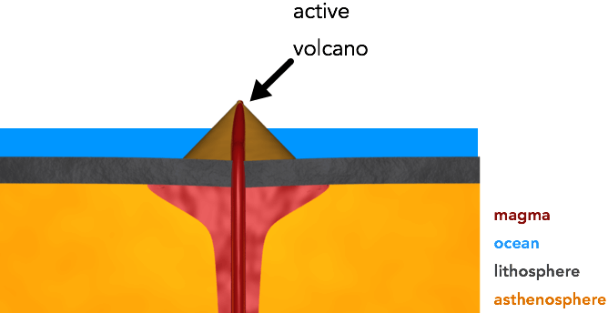
A hotspot is a body of magma that sits just under the lithosphere. It can occur under any type of crust, whether oceanic or continental.
Magma from this hotspot can rise up to the Earth's surface and erupt, forming a volcano.
Hotspot volcanoes can contain a wide variety of rock types, but they mostly look just like the volcanoes you would find above a rift zone or subduction zone.

